Slide 1
EMS Intranet
Brian W. Smith
Under the Hood with the New EMS Website
Cardinal Health
April 23, 2004

Slide 2
Agenda
Site Objective
Server and IIS Details
Programming Details
Site Review
Site Support
Brief look at the Admin Site
Q&A

Slide 3
Objective of Intranet Site
Provide up to date information to end users.
Provide automated processing and real time reporting.
Provide a gateway for end users to communicate directly with an EMS representative.
Provide correct up to date information to reduce the total amount of help desk calls received regarding E-Mail.
Allow users to easily find the information and tools they are looking for.

Slide 4
Server Information
Server Name
DUBEMSAPP01
OS
Windows Server 2003 Enterprise
CPU
2.4GHz
RAM
2.5GB
Drive Configuration
C:(System) – 8GB
D:(File Server) – 146GB
S:(Swap) – 8GB
W:(Web) – 8GB
Backup
Remote Backup from DUBEXPF01

Slide 5
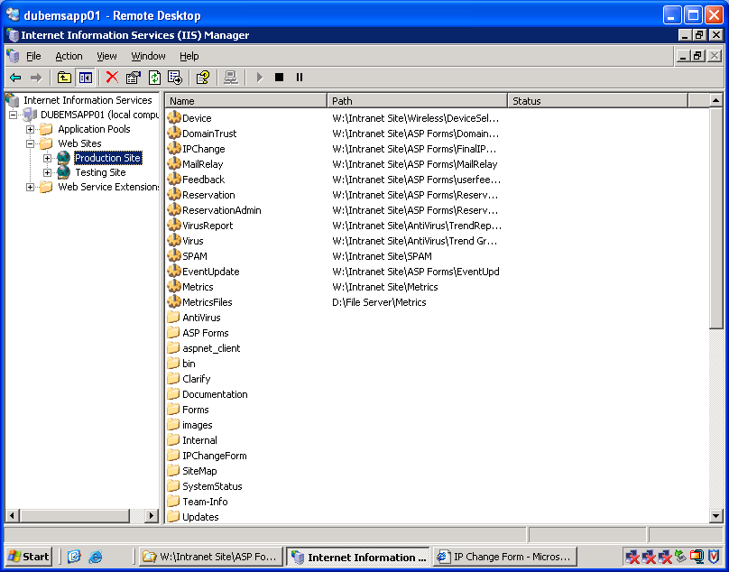
IIS Configuration
IIS Layout
DUBEMSAPP01 is configured to host the production web site on port 80 and a testing site on port 83. All design changes or page additions should be tested on the testing site first.

Slide 6

IIS Configuration Cont…
ASP.Net Pages
ASP.Net requires all pages be configured as application. This special configuration can be accomplished by creating a new virtual directory in IIS and directing it to the folder the .aspx file is contained. These pages can be identified by their unique folder icon.

Slide 7
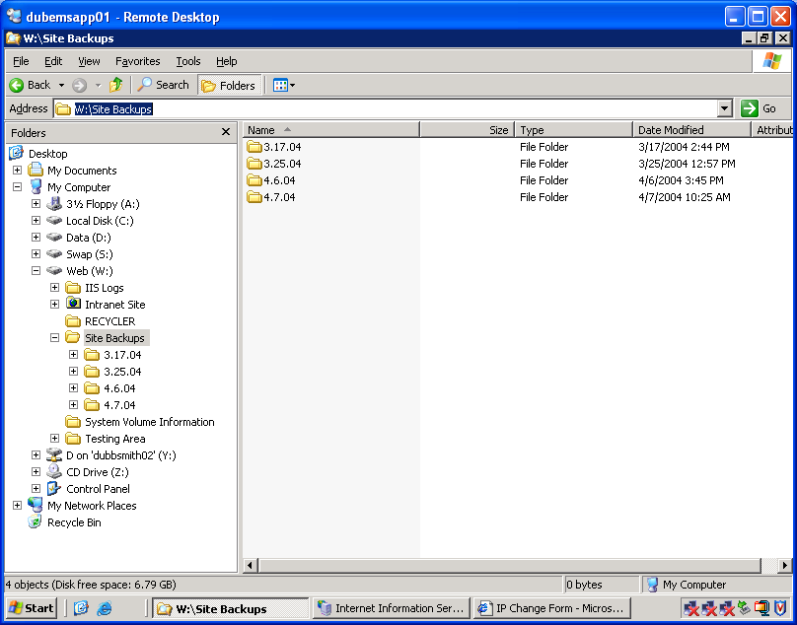
IIS Configuration Cont…
Site Backup
Before any “non-remote changes” are made to the production web site a manual site backup must be performed. The entire site should be copied to a new folder on W:\Site Backups named by the current date. By copying the entire site to a backup folder we are able to restore the entire site in seconds.
*non-remote changes – any change made to the site requiring a site upload. More detail can be found in the Intranet Support Guide

Slide 8
Programming Details
Many different programming languages have been used to accomplish many different tasks. All code has been fully commented to allow updates if needed. Because this is an intranet site you will find many Solution files that would be removed from an Internet site. Folder browsing has been turned off and this should be adequate for an intranet server.

Slide 9
Programming Languages Used on Site
Visual Basic.Net
Visual Basic Script
Java Script
C#
ASP.Net
ASP
XML
HTTP
Action Script

Slide 10
EMS Homepage
The Homepage to EMS Intranet site should be welcoming to the user by using corporate approved colors and an easy to navigate system.

Slide 11
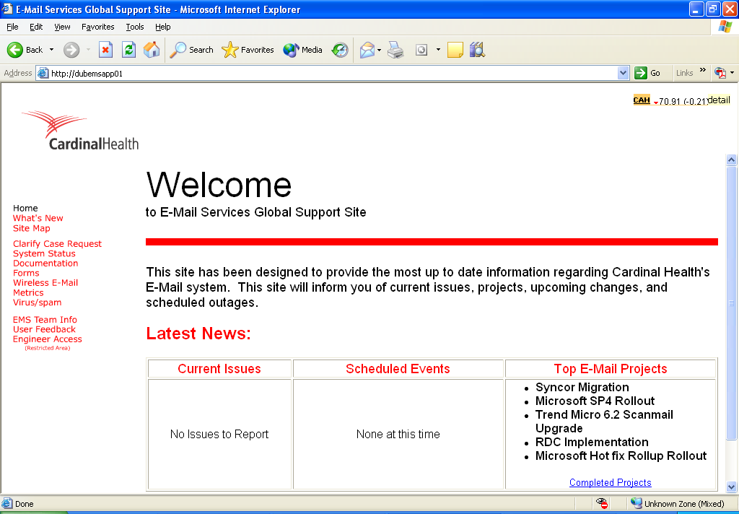
EMS Homepage
The Homepage to EMS Intranet site should be welcoming to the user by using corporate approved colors and an easy to navigate system.

Slide 12
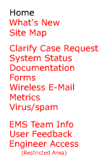
EMS Homepage Cont…
Menu
Menu.htm has been designed to provide an easy to navigate menu. Users often find themselves lost in the hierarchy of many web sites. Providing a menu that does not change from page to page will allow the user to navigate freely throughout the site. Menu.htm consists of one link to Menu.swf.

Slide 13
EMS Homepage Cont…
Menu.swf
Menu.swf was created with Macromedia’s Flash. In designing the site many different options were considered, but Flash was the best suited. By using a Flash menu we were able to produce a professional looking menu and reducing the complexity of maintaining multiple HTML menus. When changes are made to the menu, they are made in one file.

Slide 14
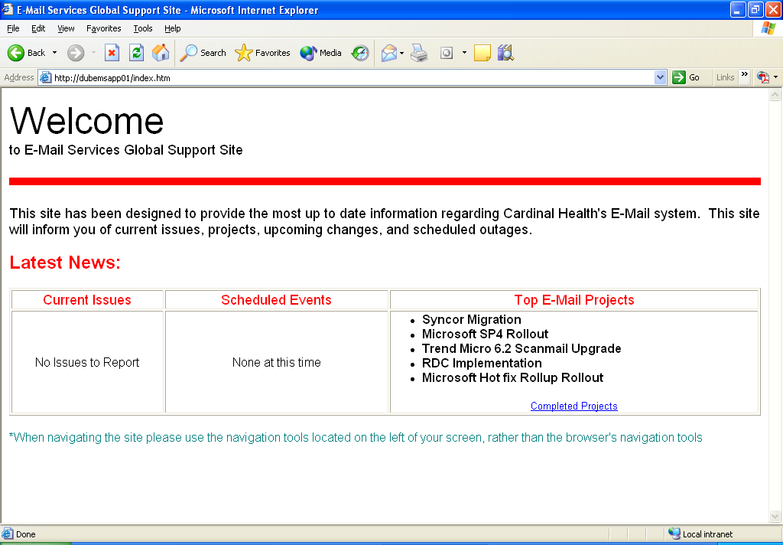
EMS Homepage Cont…
Index
Index.htm is designed to give the user a quick look at what is currently happening in E-Mail. This page shows Current Issues, Scheduled Changes, and Top Projects. All 3 headers have links to their individual pages.

Slide 15
EMS Homepage Cont…
Index Cont…
“Current Issues” will contain information on any long term Priority 1 issues.
Any scheduled outages should appear in the “Scheduled Events” area.
“Top E-Mail Projects” will contain a list of current E-Mail services projects.
These sections must be kept up to date and updated often.

Slide 16
Clarify Case Request
The Clarify Case Request forms allow our Technical Contacts at remote sites, who do not have Clarify, to submit a ticket directly into the Clarify system. Once the form is submitted an email is sent to Cardinal Messenger, where Clarify Email Clerk generates a Clarify case based on the emails contents.

Slide 17
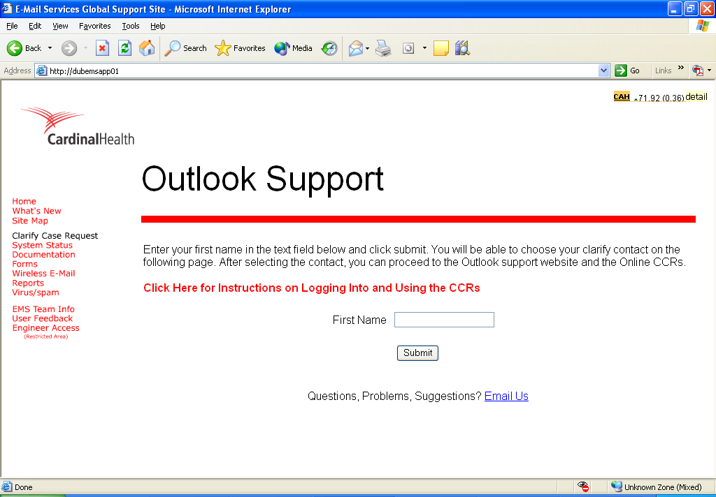
Clarify Case Request
The Clarify Case Request forms allow our Technical Contacts at remote sites, who do not have Clarify, to submit a ticket directly into the Clarify system. Once the form is submitted an email is sent to Cardinal Messenger, where Clarify Email Clerk generates a Clarify case based on the emails contents.

Slide 18
System Status
System Status acts as a gateway to Known Issues, Events, and Projects

Slide 19
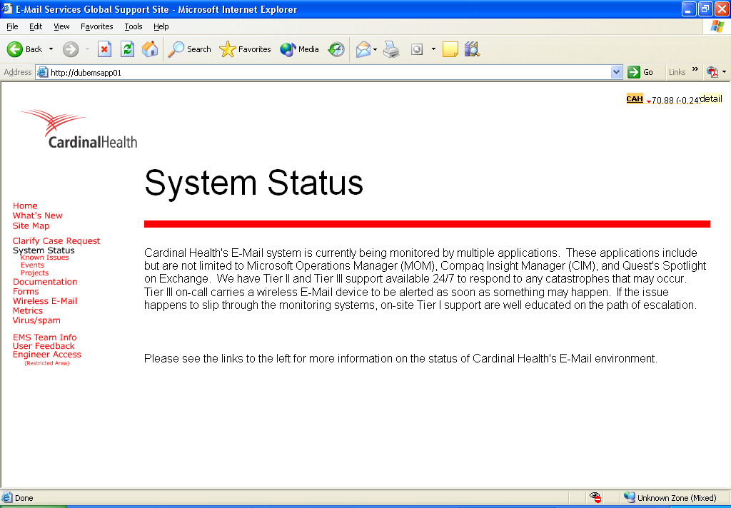
System Status
System Status acts as a gateway to Known Issues, Events, and Projects

Slide 20
System Status Cont…
Known Issues
Known issues details all long term issues affecting E-Mail.

Slide 21
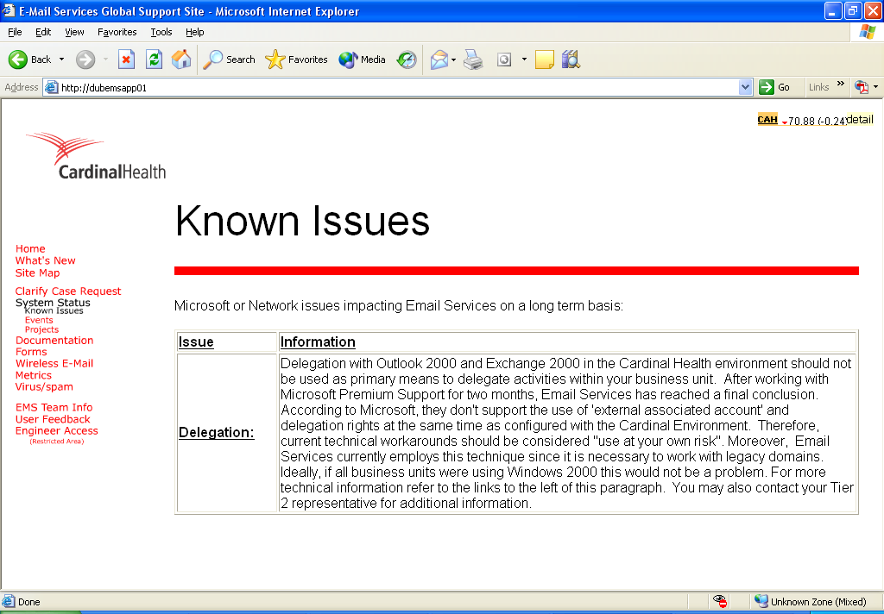
System Status Cont…
Known Issues
Known issues details all long term issues affecting E-Mail.

Slide 22
System Status Cont…
Events
E-Mail Services Events consists of Unscheduled Events, Schedules Events, and Resolved Events. The lists of events are dynamically updated by the contents in: W:\Intranet Site\Updates\Resolved Events, Scheduled Events, and Unscheduled Events
Events can be added and resolved by using the EMS admin tool located: http://dubemsapp01/EventUpdate/EventUpd2.aspx

Slide 23
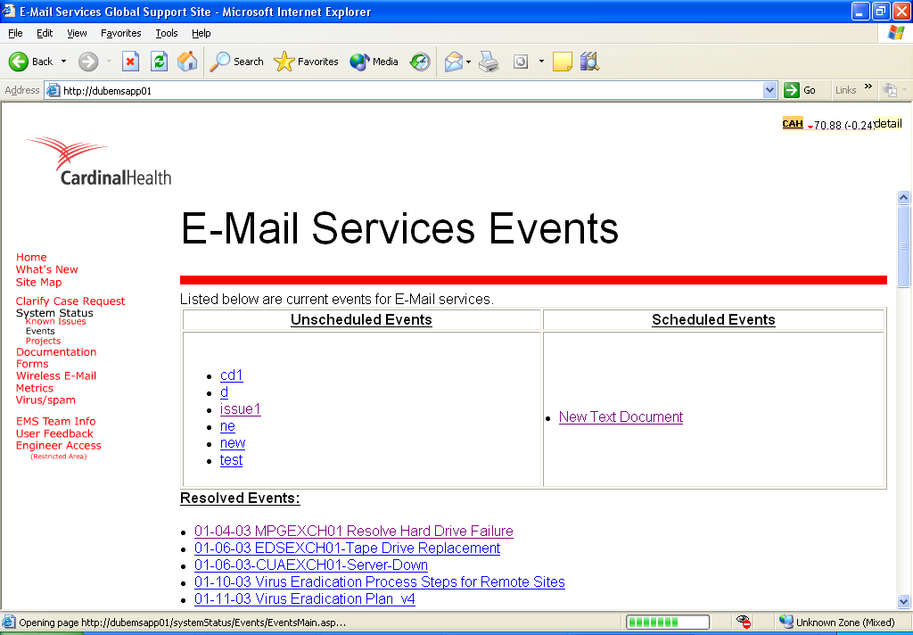
System Status Cont…
Events
E-Mail Services Events consists of Unscheduled Events, Schedules Events, and Resolved Events. The lists of events are dynamically updated by the contents in: W:\Intranet Site\Updates\Resolved Events, Scheduled Events, and Unscheduled Events
Events can be added and resolved by using the EMS admin tool located: http://dubemsapp01/EventUpdate/EventUpd2.aspx

Slide 24
System Status Cont…
Projects
The Projects page displays a dynamically updated list of all current and past projects of EMS.

Slide 25
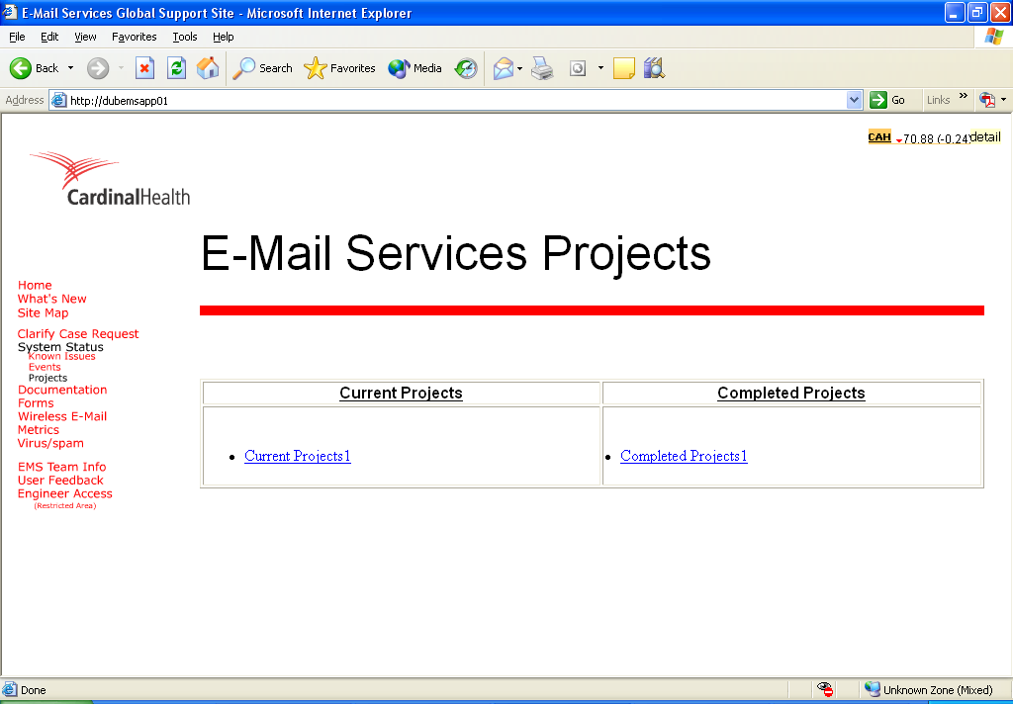
System Status Cont…
Projects
The Projects page displays a dynamically updated list of all current and past projects of EMS.

Slide 26
Documentation
Documentation acts as a gateway to Exchange Info and E-Mail Policies

Slide 27
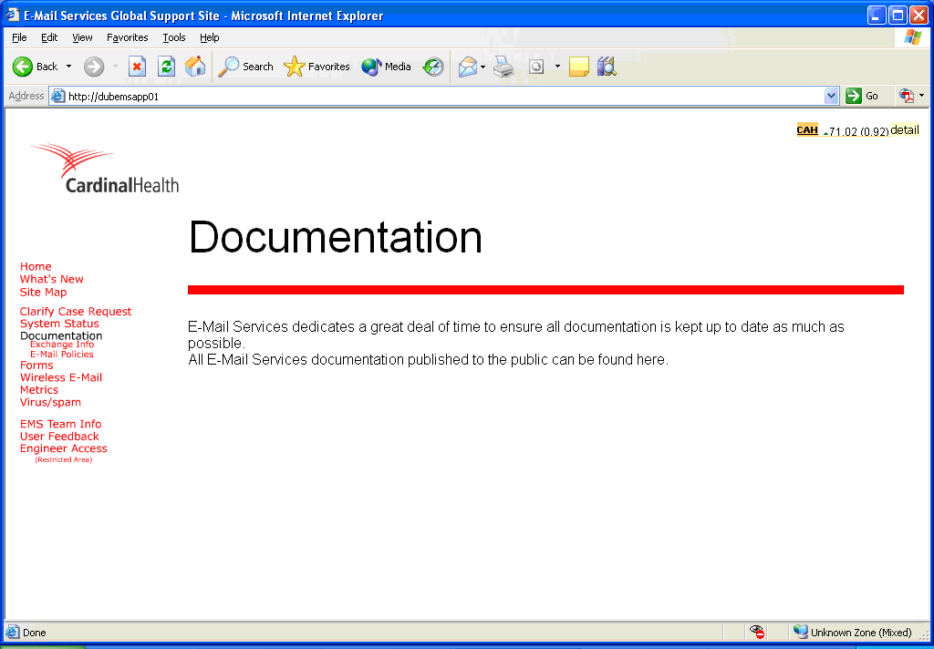
Documentation
Documentation acts as a gateway to Exchange Info and E-Mail Policies

Slide 28
Documentation Cont…
Exchange Documentation
Exchange Info contains Exchange Topology Diagrams, Server Cabling diagrams, Backup Documentation, and any other documents that may be of interest to users.

Slide 29
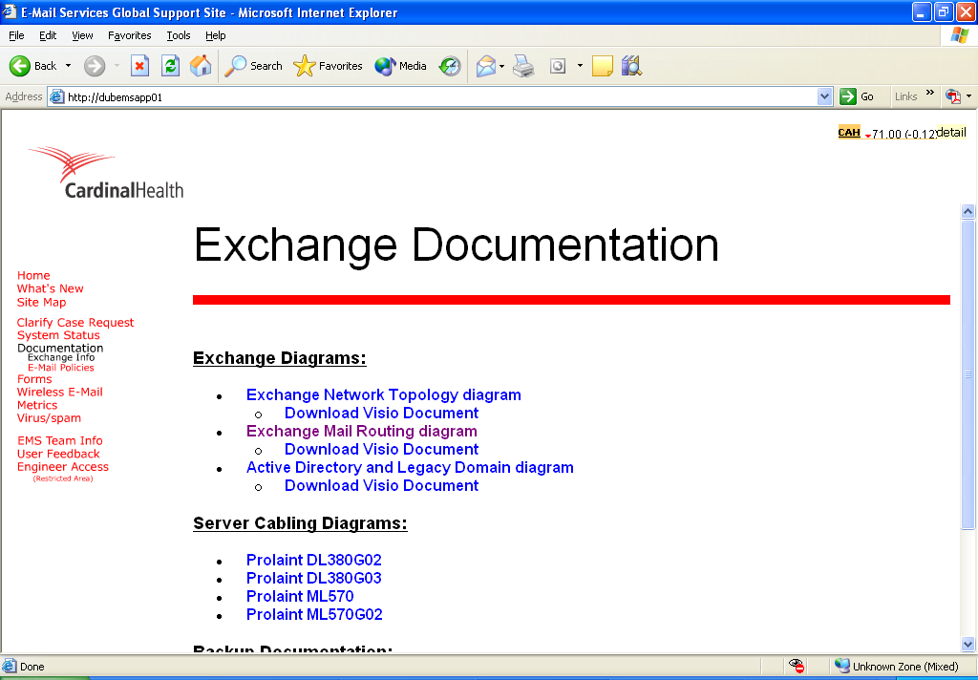
Documentation Cont…
Exchange Documentation
Exchange Info contains Exchange Topology Diagrams, Server Cabling diagrams, Backup Documentation, and any other documents that may be of interest to users.

Slide 30
Documentation Cont…
E-Mail Policies
E-Mail Policies contains all EMS Policies. Allowing users easily answer questing regarding policies enforced by E-Mail Services

Slide 31
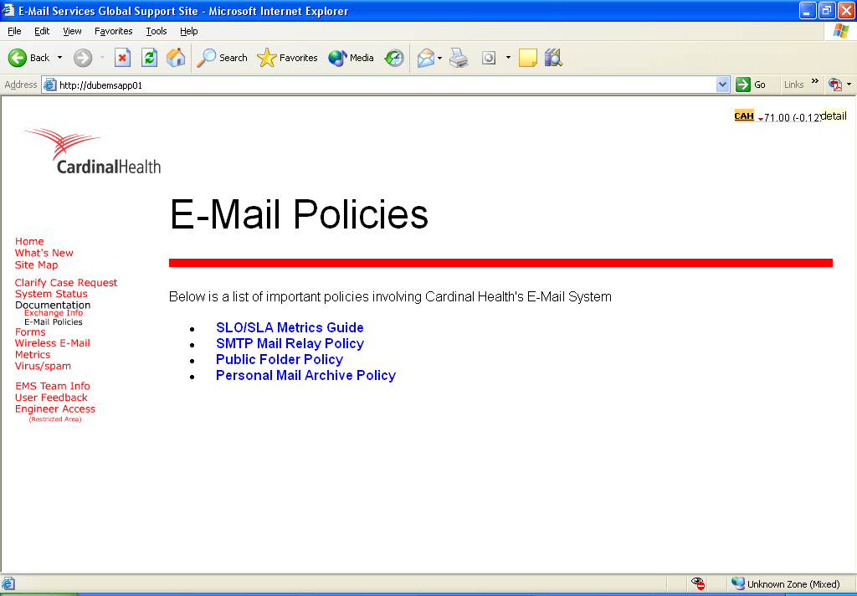
Documentation Cont…
E-Mail Policies
E-Mail Policies contains all EMS Policies. Allowing users easily answer questing regarding policies enforced by E-Mail Services

Slide 32
Forms
“Forms” contains all forms to be used to request changes from EMS.
Mail Relay, IP Change and Domain Trust Forms have been created with ASP.Net.

Slide 33
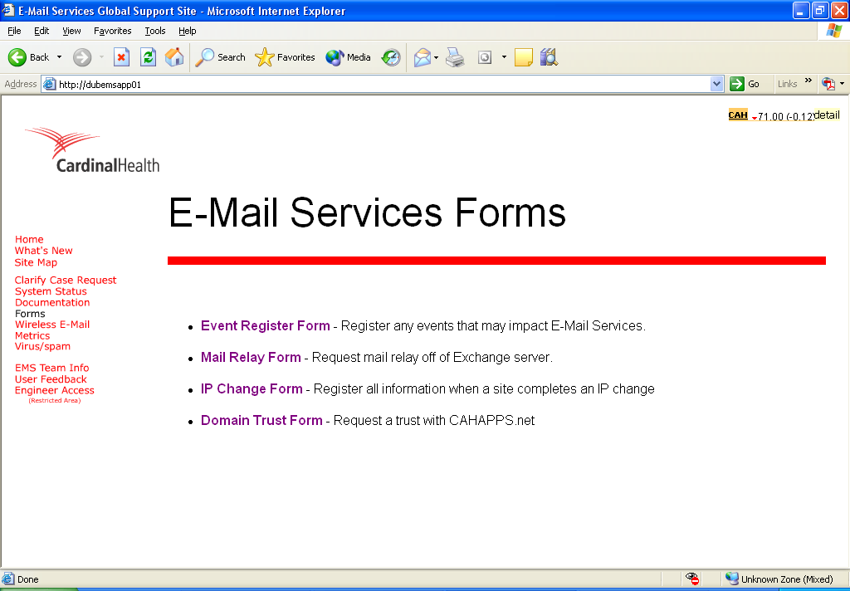
Forms
“Forms” contains all forms to be used to request changes from EMS.
Mail Relay, IP Change and Domain Trust Forms have been created with ASP.Net.

Slide 34
Forms Cont…
Mail Relay Form
The Mail Relay form allows a user to request a mail relay opening to an application. When the form is submitted, an e-mail is sent to the user requesting and Tier III. The data is also inserted into a SQL database to archive for later reference.

Slide 35
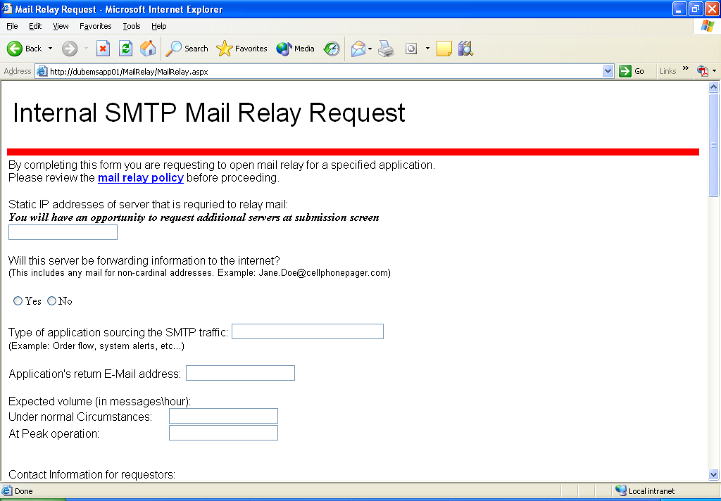
Forms Cont…
Mail Relay Form
The Mail Relay form allows a user to request a mail relay opening to an application. When the form is submitted, an e-mail is sent to the user requesting and Tier III. The data is also inserted into a SQL database to archive for later reference.

Slide 36
Forms Cont…
IP Change Form
The Server IP Change form allows a remote admin to inform EMS of an upcoming IP Change. When the form has been completed an e-mail is sent to requesting party and Tier III. The data is also inserted into a SQL Database for future reference.

Slide 37
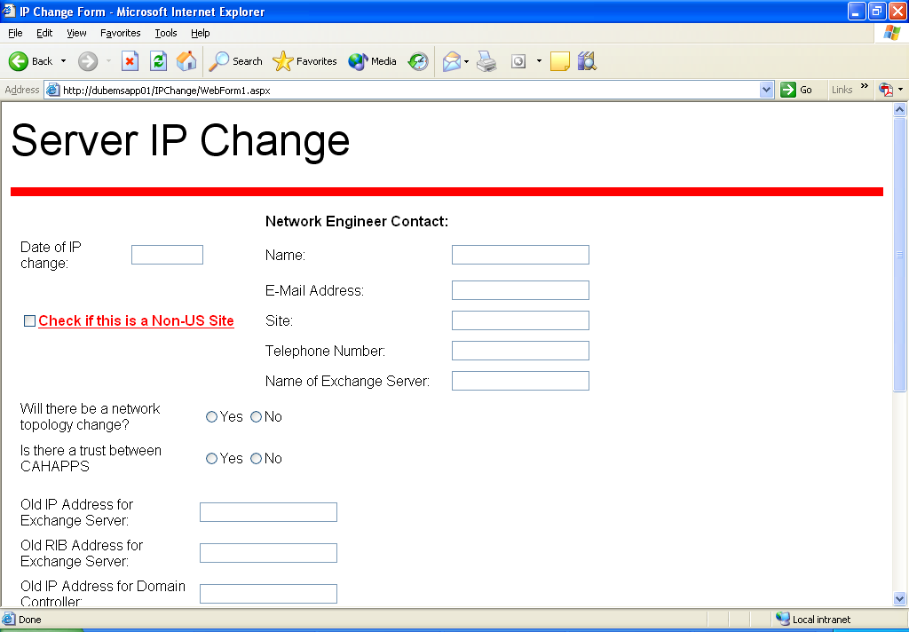
Forms Cont…
IP Change Form
The Server IP Change form allows a remote admin to inform EMS of an upcoming IP Change. When the form has been completed an e-mail is sent to requesting party and Tier III. The data is also inserted into a SQL Database for future reference.

Slide 38
Forms Cont…
Domain Trust Form
Domain Trust request allows a remote admin to request a trust with CAHAPPS.net. When the form has been completed an e-mail is sent to the requesting party and Tier III. This information is also inserted into a SQL database for future reference.

Slide 39
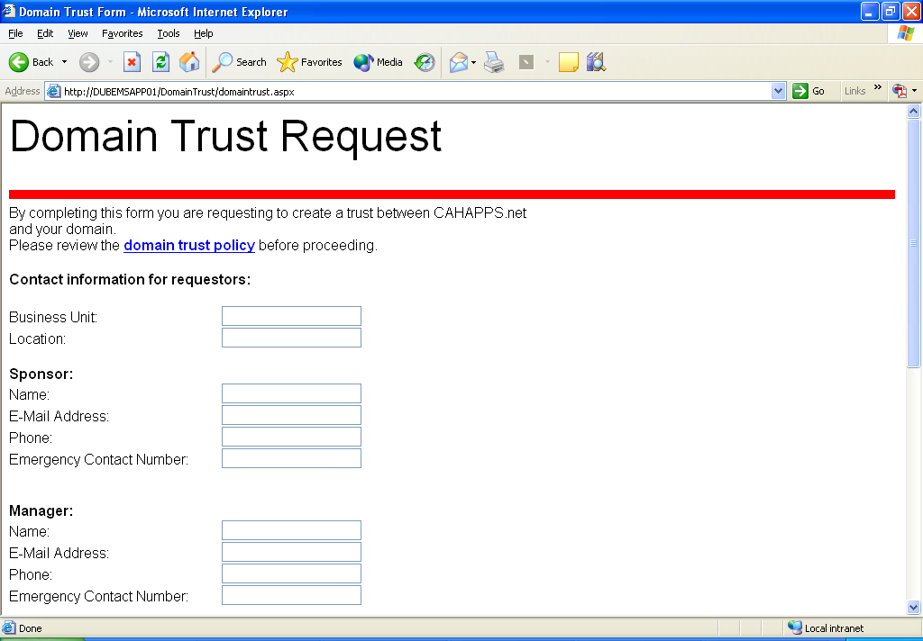
Forms Cont…
Domain Trust Form
Domain Trust request allows a remote admin to request a trust with CAHAPPS.net. When the form has been completed an e-mail is sent to the requesting party and Tier III. This information is also inserted into a SQL database for future reference.

Slide 40
Forms Cont…
Future Forms
Application Integration Initiation Request Form
Form to be used to create a process for EMS to approve applications before they are integrated into our system.

Slide 41
Wireless E-Mail
Wireless E-Mail provides information about all the different BlackBerry models available. Each model contains a link with a page holding downloads for the device. This page also acts as a gateway to the Device selection tool.

Slide 42
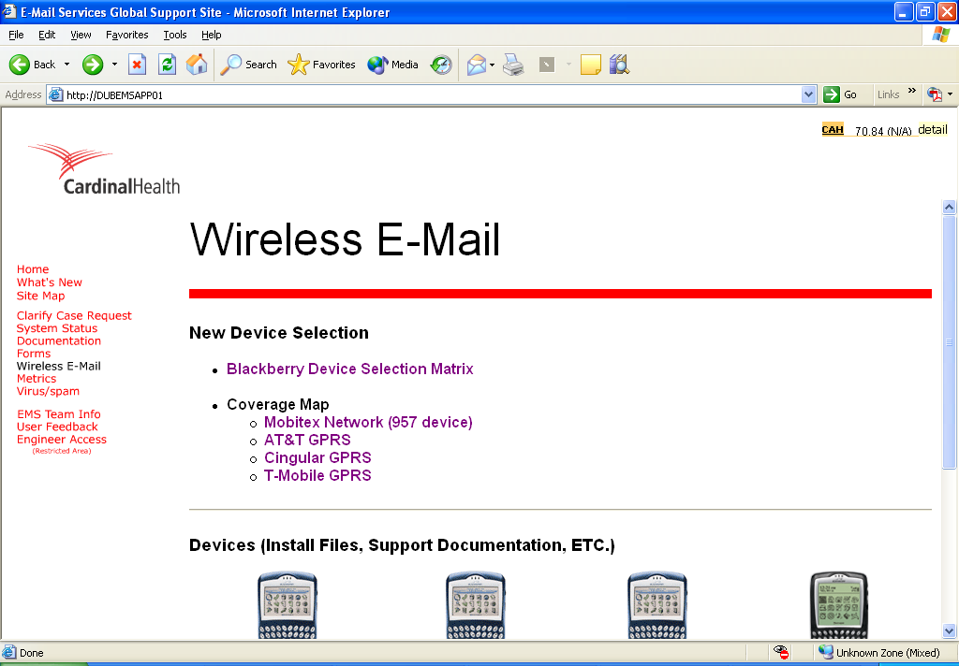
Wireless E-Mail
Wireless E-Mail provides information about all the different BlackBerry models available. Each model contains a link with a page holding downloads for the device. This page also acts as a gateway to the Device selection tool.

Slide 43
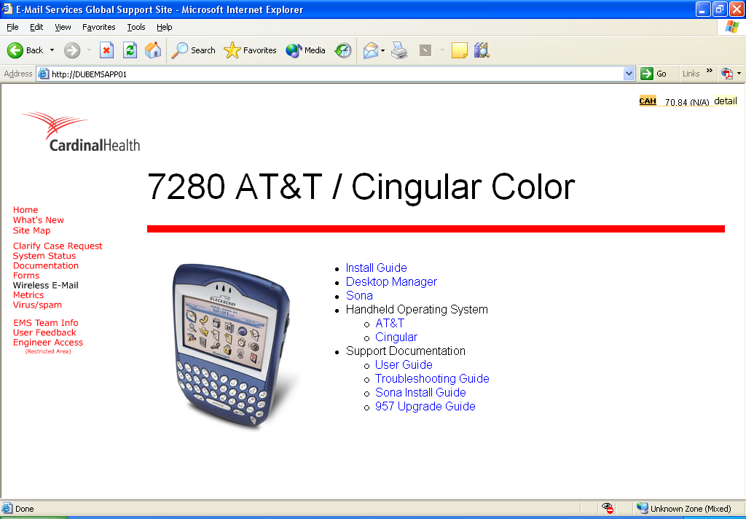
Wireless E-Mail
Wireless E-Mail provides information about all the different BlackBerry models available. Each model contains a link with a page holding downloads for the device. This page also acts as a gateway to the Device selection tool.

Slide 44
Wireless E-Mail Cont…
Device Selection Tool
The Device selection tool is an ASP.Net page communicating with an Access database located on DUBEMSAPP01. Any changes made to this Database will appear on the page results. Database is located: W:\Intranet Site\Wireless\DeviceSelection\Blackberry\db3.mdb

Slide 45
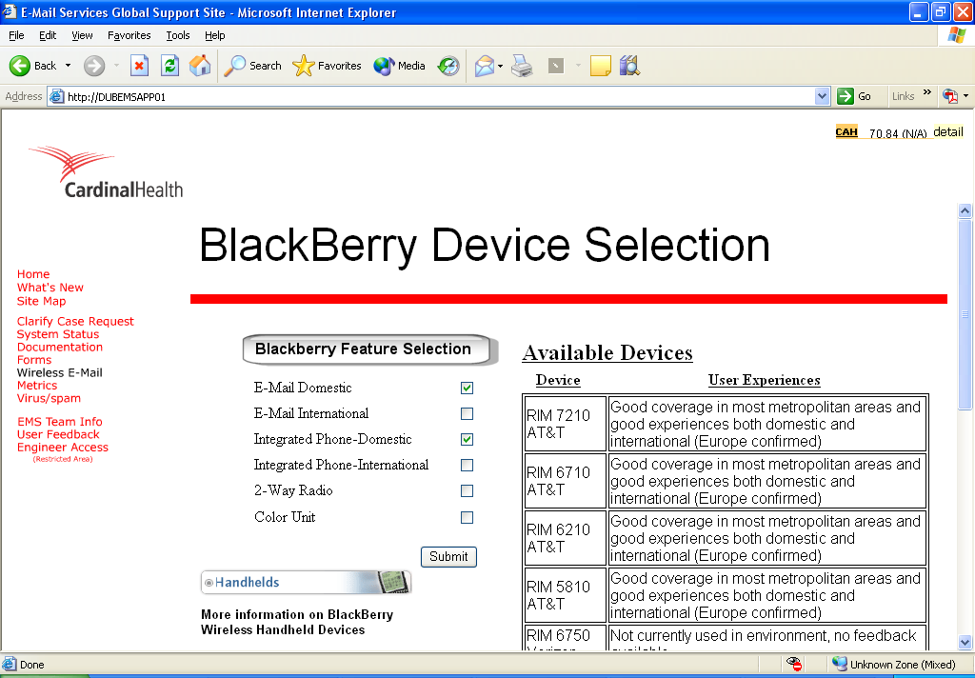
Wireless E-Mail Cont…
Device Selection Tool
The Device selection tool is an ASP.Net page communicating with an Access database located on DUBEMSAPP01. Any changes made to this Database will appear on the page results. Database is located: W:\Intranet Site\Wireless\DeviceSelection\Blackberry\db3.mdb

Slide 46
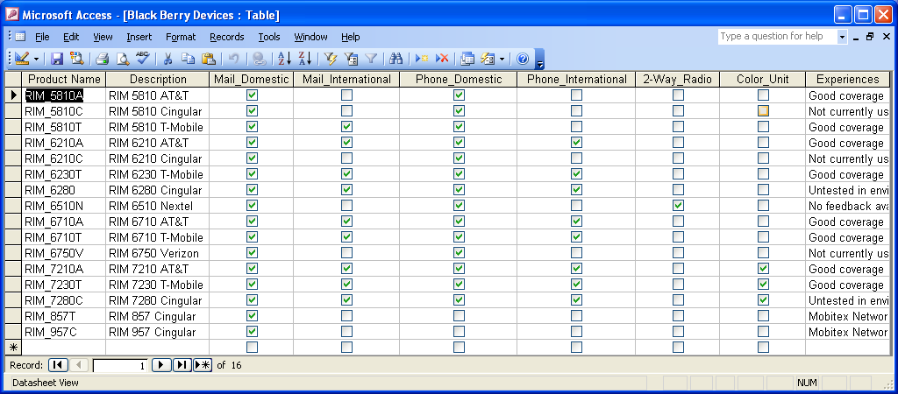
Wireless E-Mail Cont…
Device Selection Tool
The Device selection tool is an ASP.Net page communicating with an Access database located on DUBEMSAPP01. Any changes made to this Database will appear on the page results. Database is located: W:\Intranet Site\Wireless\DeviceSelection\Blackberry\db3.mdb

Slide 47
Reporting
Exchange Documentation
Reporting allows users to view all EMS Weekly reporting statistics. This page returns all files located in the following folders:
D:\File Server\Metrics\BU Metrics
D:\File Server\Metrics\Clarify Trends
D:\File Server\Metrics\Customer Sat
D:\File Server\Metrics\Dashboard
D:\File Server\Metrics\Mailbox Manager

Slide 48
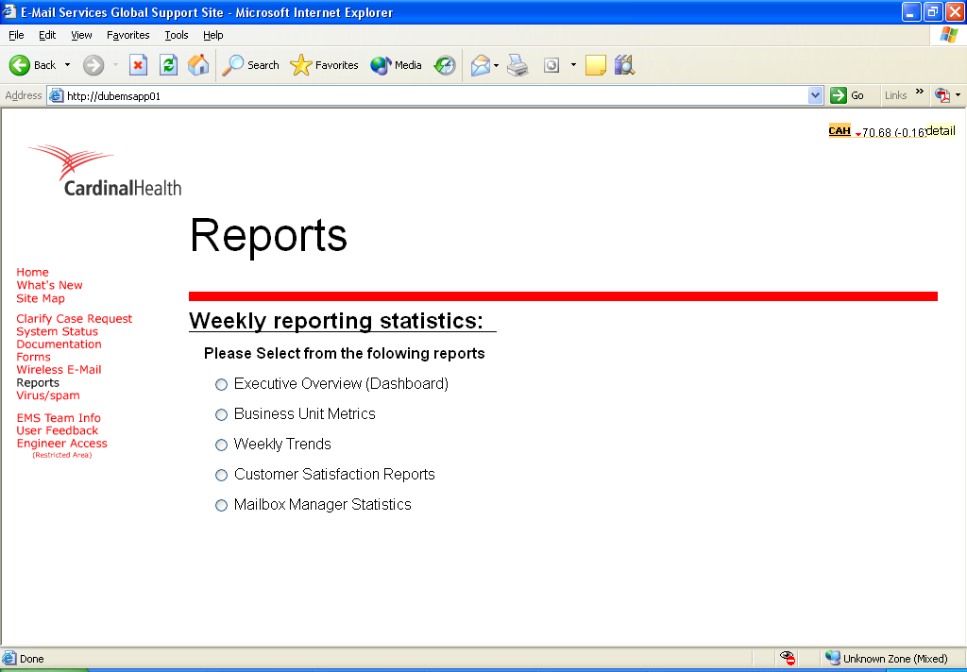
Reporting
Exchange Documentation
Reporting allows users to view all EMS Weekly reporting statistics. This page returns all files located in the following folders:
D:\File Server\Metrics\BU Metrics
D:\File Server\Metrics\Clarify Trends
D:\File Server\Metrics\Customer Sat
D:\File Server\Metrics\Dashboard
D:\File Server\Metrics\Mailbox Manager

Slide 49
Virus/spam
Virus/spam acts as a gateway to the Anti-Virus and Anti-spam pages.

Slide 50
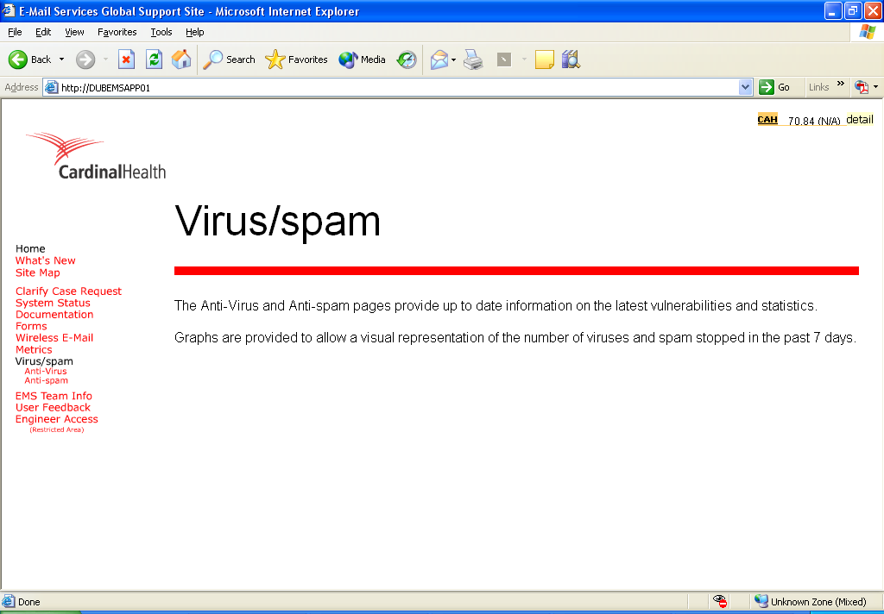
Virus/spam
Virus/spam acts as a gateway to the Anti-Virus and Anti-spam pages.

Slide 51
Virus/spam Cont…
Anti-Virus
The Anti-Virus page is designed to provide a visual representation of the number of Viruses blocked by Trend in the past 7 days.
The graph uses an HTML page containing a Flash movie, using action script, to query an ASP.Net page that queries SQL and returns XML data to the flash file. The flash file in turn uses this data to map a graph showing trends for the past 7 days including real time stats for the current day. Although this graph is fairly accurate, it does not count the number of viruses that may have been stopped by XWALL due to attachment blocking.
The page also uses code provided by Trend Anti-Virus detailing the latest Viruses released.

Slide 52
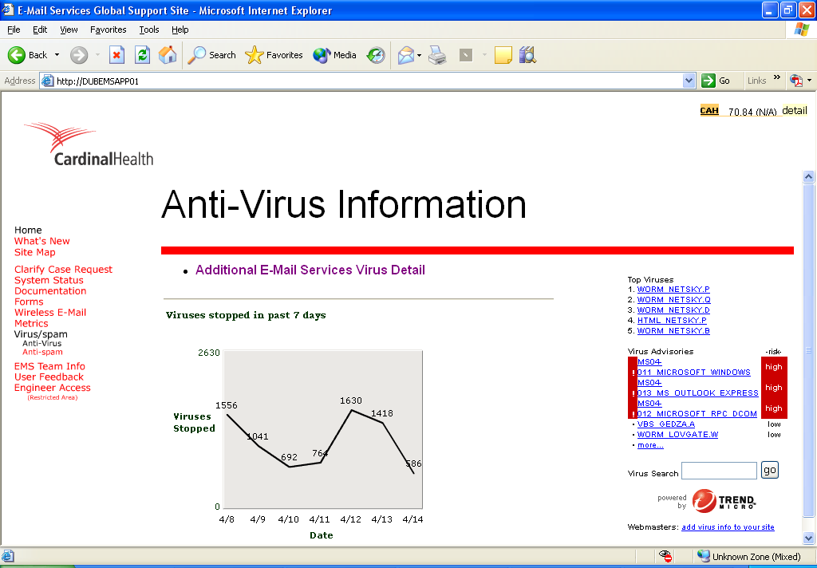
Virus/spam Cont…
Anti-Virus
The Anti-Virus page is designed to provide a visual representation of the number of Viruses blocked by Trend in the past 7 days.
The graph uses an HTML page containing a Flash movie, using action script, to query an ASP.Net page that queries SQL and returns XML data to the flash file. The flash file in turn uses this data to map a graph showing trends for the past 7 days including real time stats for the current day. Although this graph is fairly accurate, it does not count the number of viruses that may have been stopped by XWALL due to attachment blocking.
The page also uses code provided by Trend Anti-Virus detailing the latest Viruses released.

Slide 53
Virus/spam Cont…
Anti-spam
The Anti-spam page utilized the same code to create the Anti-Virus Graph with minor changes. The Anti-spam graph has been extended to allow a better view of the large numbers.
Two Visual Basic scripts have been created to run every day to collect XWALL data from every SMTP server and insert the data into SQL. The first script is run on each SMTP server to parse the very large XWALL log for the current data needed. This script is run on each SMTP server at 12:15 AM daily. Another script is run on DUBEXSM01, at 2:00 AM, to gather the data from each SMTP server and insert it into the SQL database.

Slide 54
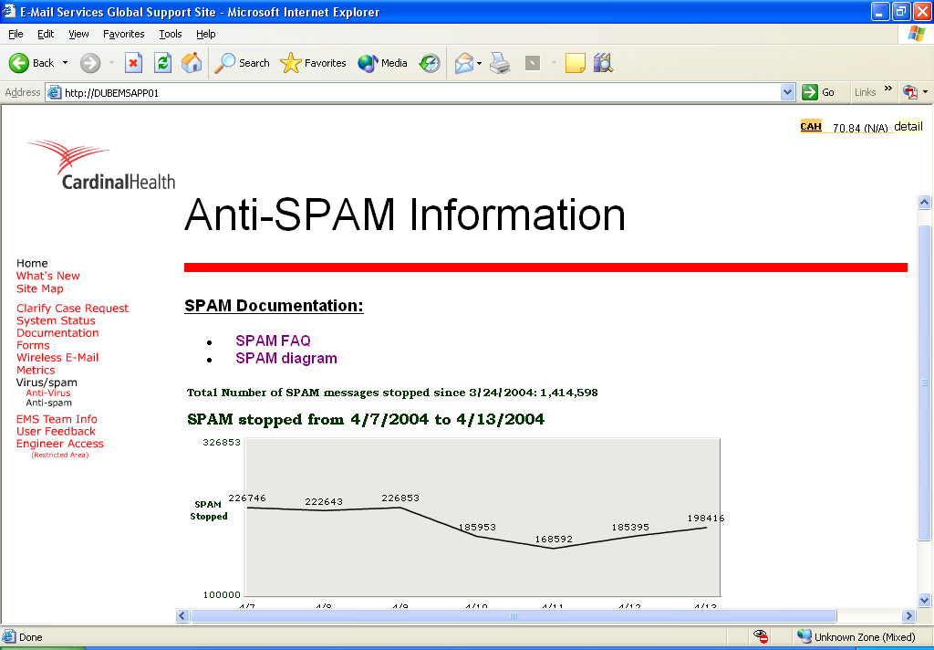
Virus/spam Cont…
Anti-spam
The Anti-spam page utilized the same code to create the Anti-Virus Graph with minor changes. The Anti-spam graph has been extended to allow a better view of the large numbers.
Two Visual Basic scripts have been created to run every day to collect XWALL data from every SMTP server and insert the data into SQL. The first script is run on each SMTP server to parse the very large XWALL log for the current data needed. This script is run on each SMTP server at 12:15 AM daily. Another script is run on DUBEXSM01, at 2:00 AM, to gather the data from each SMTP server and insert it into the SQL database.

Slide 55
User Feedback
User Feedback allows users to leave Feedback for EMS. The user can select to leave the feedback anonymously or request feedback.
This page uses ASP.Net with C# to place the data entered from the form into feedback.xml. The ViewFeedback admin page uses Feedback.xls to view the information in feedback.xml.

Slide 56
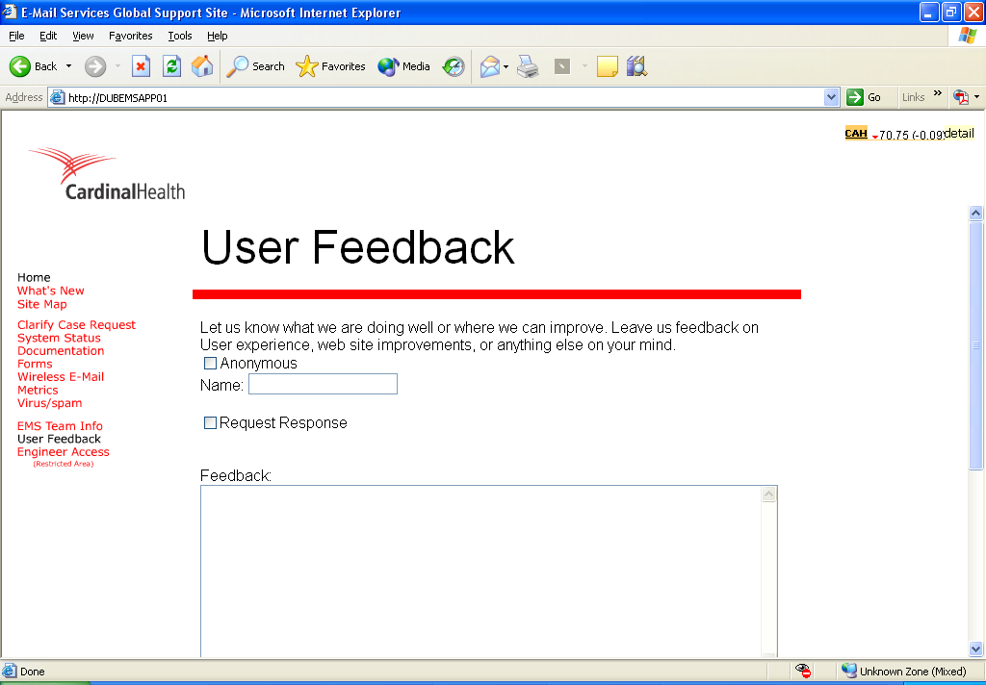
User Feedback
User Feedback allows users to leave Feedback for EMS. The user can select to leave the feedback anonymously or request feedback.
This page uses ASP.Net with C# to place the data entered from the form into feedback.xml. The ViewFeedback admin page uses Feedback.xls to view the information in feedback.xml.

Slide 57
Intranet Site Support
This site has been designed to reduce manual updates as much as possible. By doing this, the site can be updated and changed without needing access to any HMTL editing software.
The current state of the site requires Microsoft FrontPage to complete the updates. 99% of the updates to be completed should only by remote updates, not requiring anything to be uploaded to the server. By doing this we are able to reduce the chances of disrupting service.

Slide 58
Admin Site
Current State
As Pages are created links will be added to the Admin Homepage.
Security has been set only allowing “G-Exchange Full Administrators” access to this site. This allows us to place passwords and other documents users should not see on this site.

Slide 59
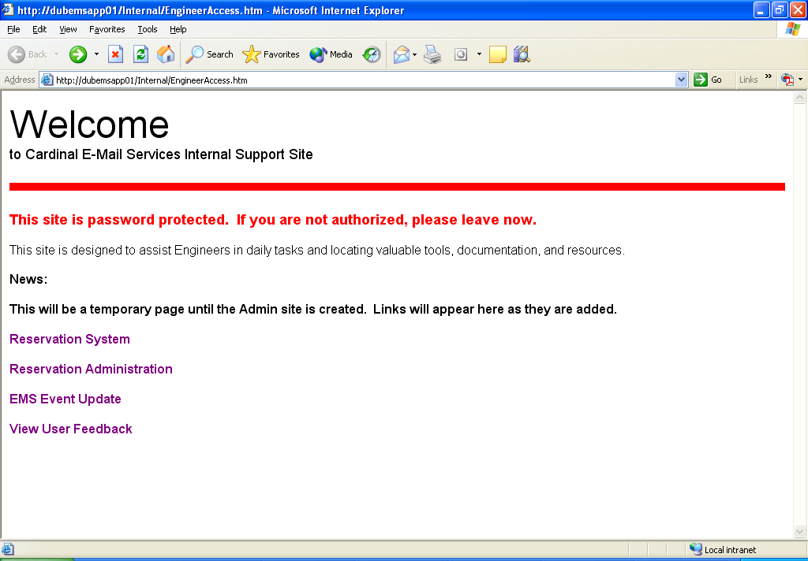
Admin Site
Current State
As Pages are created links will be added to the Admin Homepage.
Security has been set only allowing “G-Exchange Full Administrators” access to this site. This allows us to place passwords and other documents users should not see on this site.

Slide 60
Admin Site Cont…
Reservation System
The Reservation System was designed to remove the confusion from the lab hardware. In the past no one knew who was using wat hardware with what IP addresses. This system allows an EMS Engineer to check out a server for a period of time. Once the form has been completed and E-Mail is sent to Tony Dorto, Brian Hanlin, and the requesting Engineer. The data entered is also inserted into a SQL database, and put into a “pending” state.

Slide 61
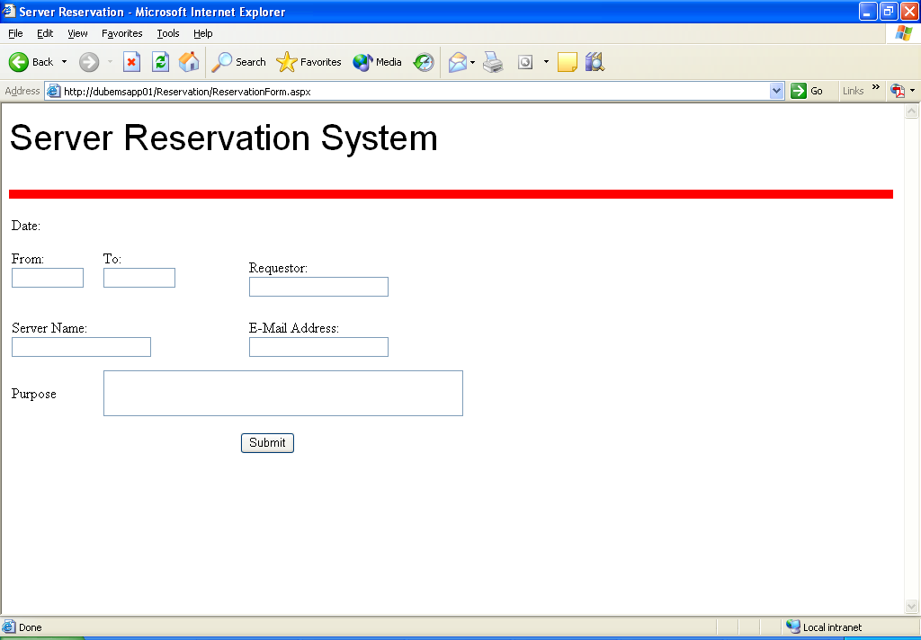
Admin Site Cont…
Reservation System
The Reservation System was designed to remove the confusion from the lab hardware. In the past no one knew who was using wat hardware with what IP addresses. This system allows an EMS Engineer to check out a server for a period of time. Once the form has been completed and E-Mail is sent to Tony Dorto, Brian Hanlin, and the requesting Engineer. The data entered is also inserted into a SQL database, and put into a “pending” state.

Slide 62
Admin Site Cont…
Reservation Administration
The Administration page allows the Lab Admins access the Database information to modify.

Slide 63
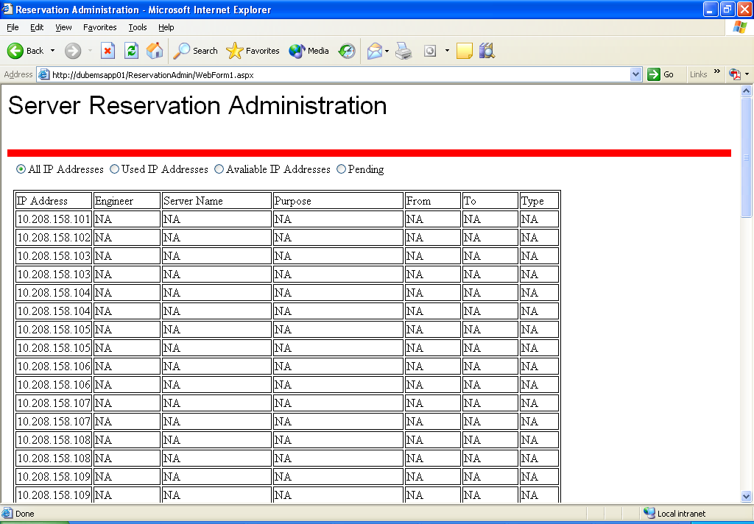
Admin Site Cont…
Reservation Administration
The Administration page allows the Lab Admins access the Database information to modify.

Slide 64
Admin Site Cont…
Vision
The Admin site will contain all information needed to support Exchange. This page will include the Server Support Database, Contact numbers, and documents.
I would also like to create a FAQ/Knowledge base. This page could be a place to search all issues we have encountered with the fix we performed. I would also like the FAQ to contain a form for EMS members to enter any questions that arise that they do not know (IE “Which lotus notes server is still routing mail to Exchange?”). Later an EMS member can access this question and submit it to the searchable FAQ/Knowledge Base.

Slide 65


Q&A

Slide 66
Thank you for taking time to understand the new EMS Intranet Site

Slide 67


